Slide 1
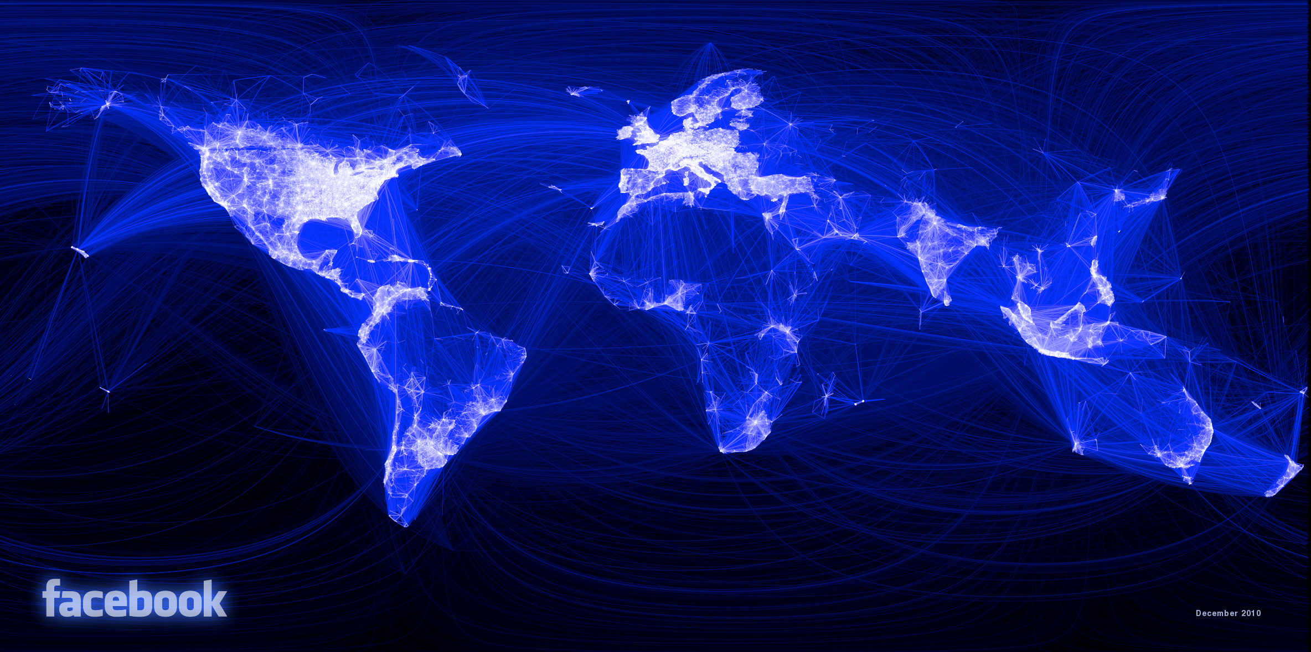

Slide 2
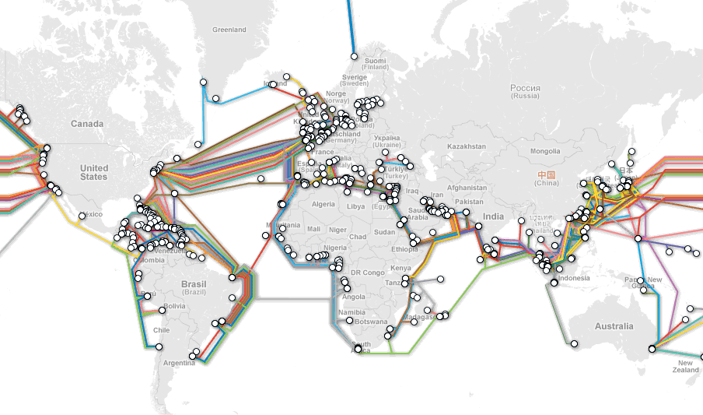

Slide 3
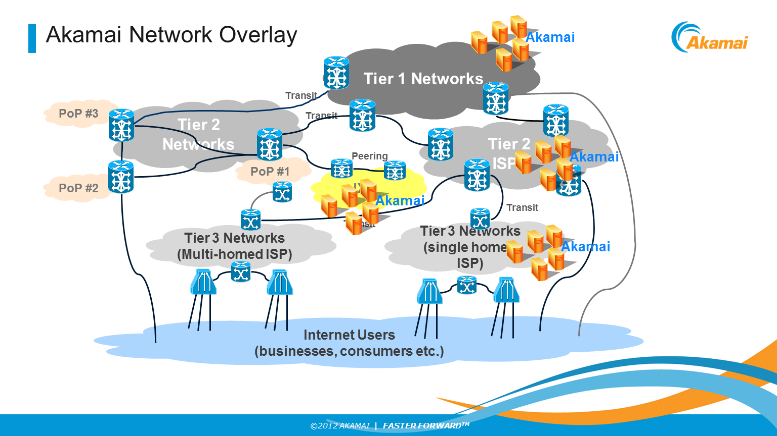
Notes:
1500+ locations
1000 networks
70+ countries
15-30% of internet traffic on any given day

Slide 4
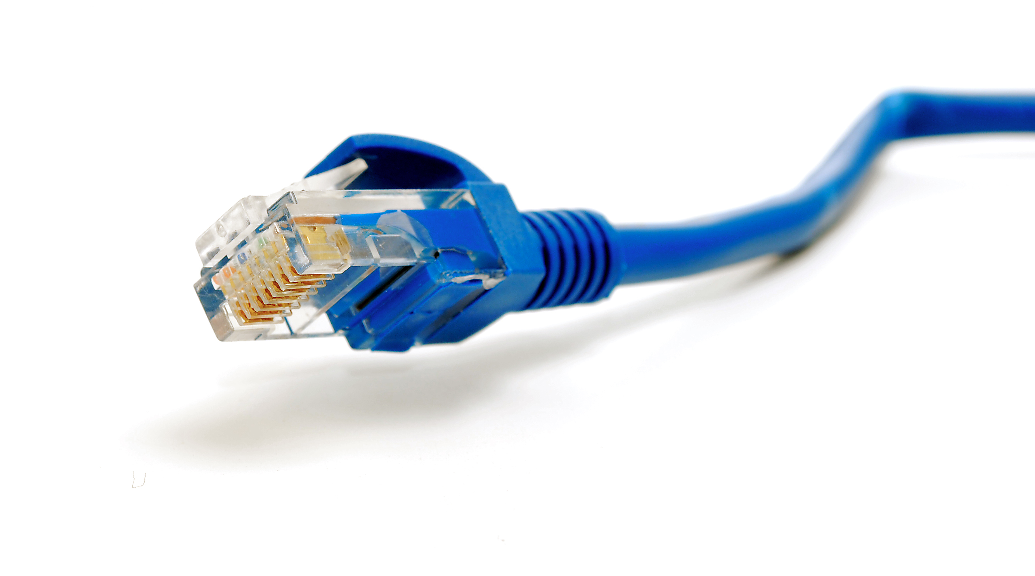
Why is the internet where it is?

Slide 5



Theories

Slide 6
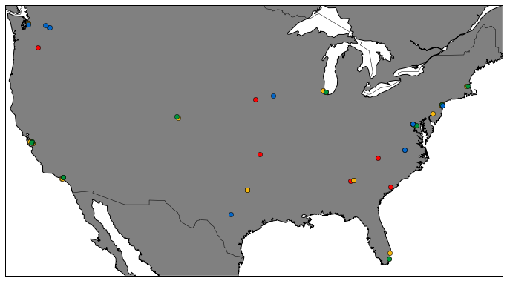
Data Centers

Slide 7
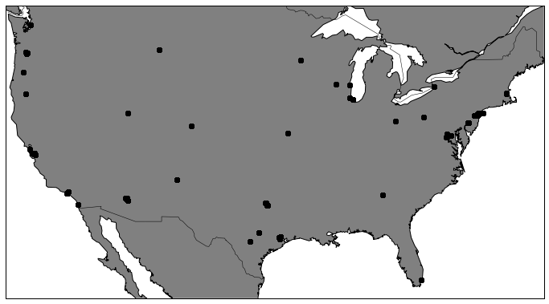
Exchange Points

Slide 8
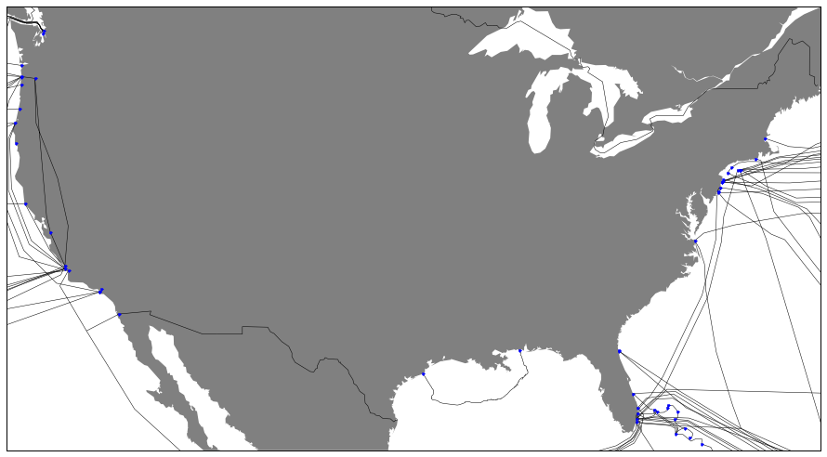
Undersea Cables/Connection Points

Slide 9
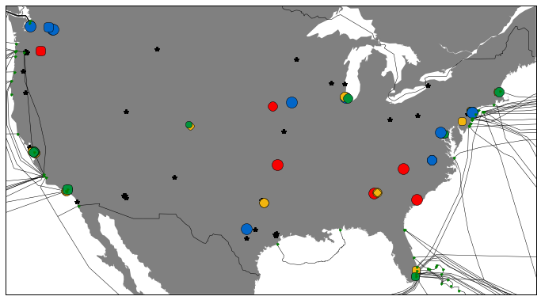
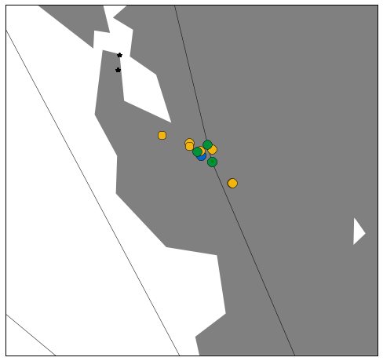
Physical Internet Infrastructure

Slide 10
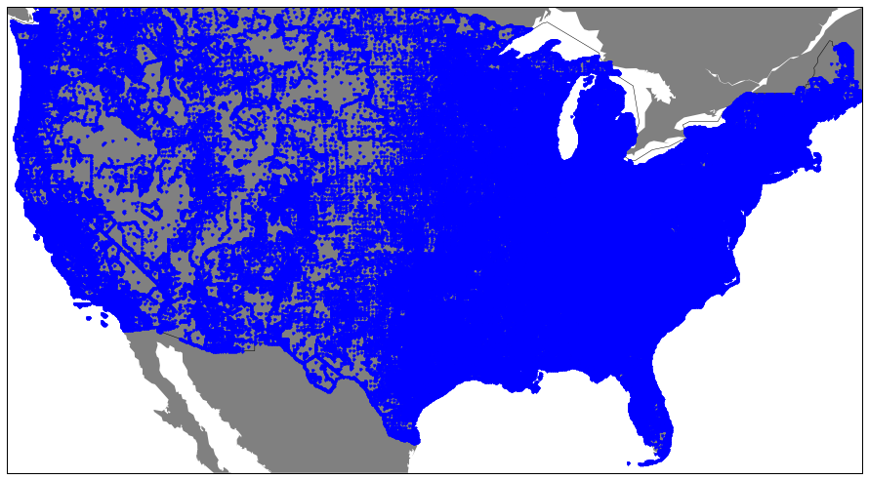
Population Density

Slide 11
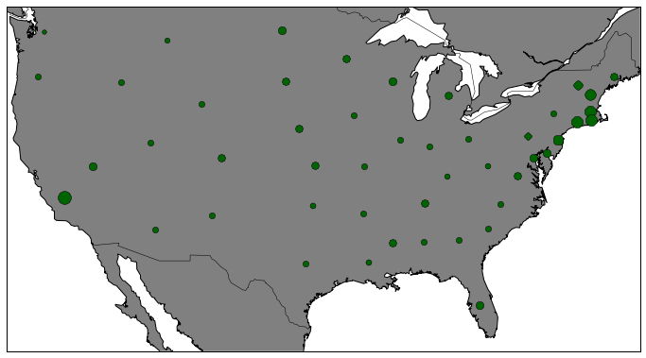
Electricity Prices

Slide 12
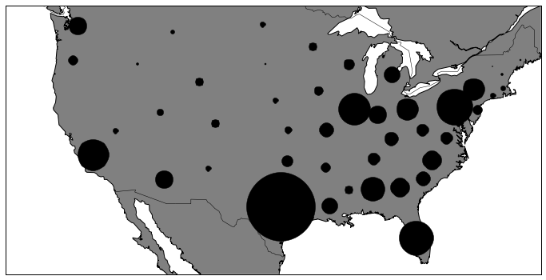
Electricity Production

Slide 13
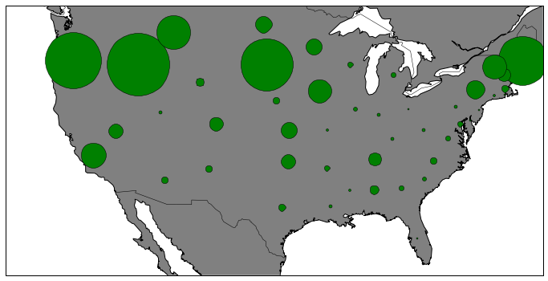
Renewable Production

Slide 14
Next Steps
Spatial Autocorrelation:
Owner/Operator vs. Colocation
Datacenter size
Spatial Regression

